Slide 1
Energy models for oil and gas supply and demand: Linear Programming
Tarun Kumar
16je001895

Slide 2
OUTLINE :
Energy Modeling
Linear Programming
Standard form of LP
LP Example

Slide 3
Energy modeling
Energy modeling or energy system modeling is the process of building computer models of energy systems in order to analyse them.
Such models often employ scenario analysis to investigate different assumptions about the technical and economic conditions at play.
Outputs may include the system feasibility, greenhouse gas emissions, cumulative financial costs, natural resource use, energy efficiency of the system under investigation etc.
Formulation of an energy model help in the proper allocation of available non-renewable and renewable energy sources such as oil, gas, coal, solar, wind, bioenergy and hydropower in meeting the future energy demand.

Slide 4
Energy models and systems are usually complex systems within which elements and subsystems are highly correlated, and their behaviour is hardly predictable without application of exact mathematical methods.
A number of optimization methods are available and these are subject to the very nature of a problem, the level of depth of the analysis. One of the simplest method for determination of the optimal solution in problems with several alternative solutions is the linear programming. The LP procedure will maximize or minimize a linear objective function which consists of unknown problem variables and constant coefficients.
Models often use mathematical optimization to solve for redundancy in the specification of the system.
Linear programming : Objective functions or the constraint functions are linear.
Non-Linear programming : Objective functions or the constraint functions are non-linear such as quadratic, cubic, exponential, logarithmic, etc.

Slide 5
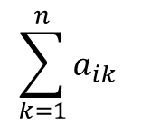
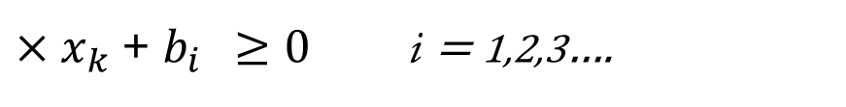
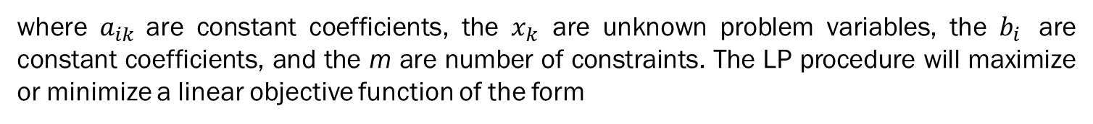
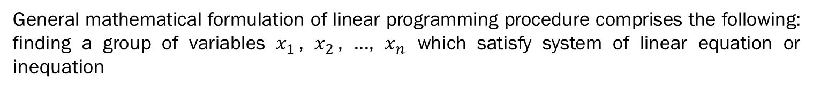
Linear Programming ?
The linear programming problem is a special subclass of programming problems. Linear programming is one of several mathematical technique that attempt to solve problems by minimizing or maximizing a function of several independent variables. The complete linear programming problem includes a set of simultaneous linear equations which represent the conditions of the problem and a linear function which expresses the problem objective.
General mathematical formulation of linear programming procedure comprises the following: finding a group of variables $x_{1 }$, $x_{2 }$, ..., $x_{n}$ which satisfy system of linear equation or inequation
$$\sum_{k=1}^{n}{a_{ik }}$$
$×x_{k}$ + $b_{i } ≥0$ i = 1,2,3….
$x_{k}$ $≥0 k=1,2,3….$
where $a_{ik }$are constant coefficients, the $x_{k}$ are unknown problem variables, the $b_{i }$ are constant coefficients, and the m are number of constraints. The LP procedure will maximize or minimize a linear objective function of the form

Slide 6

$F\left(x_{1},x_{2},x_{3}…x_{n}\right)=c_{1}.x_{1}$ + $c_{2}.x_{2}\text{+}$ …..+ $c_{n}.x_{n}$
where the ck are constant coefficients. All LP solution codes require that all variables be nonnegative $x_{k}$ ≥ 0.
Application of Linear Programming :
Linear programming can be applied to various fields of study. It is widely used in mathematics, and to a lesser extent in business, economics, and for some engineering problems. Industries that use linear programming models include transportation, energy, telecommunications, and manufacturing.
It has proven useful in modeling diverse types of problems in planning, routing, scheduling, assignment, and design

Slide 7
Standard Form
Standard form is the usual and most intuitive form of describing a linear programming problem. It consists of the following three parts:
A linear objective function to be maximized or minimized
e.g. f(x₁,x₂) =c₁ x₁+c₂ x₂
Problem constraints of the following form
e.g. a₁₁x₁ + a₁₂x₂ ≤ b₁
a₂₁x₁ + a₂₂x₂ ≤ b₂
a₃₁x₁ + a₃₂x₂ ≤ b₃
Non-negative variables
e.g. x₁ ≥ 0
x₂ ≥ 0
The problem is usually expressed in matrix form :
Max or Min {c^{T}x │ Ax ≤ b ^ x ≥ 0}

Slide 8
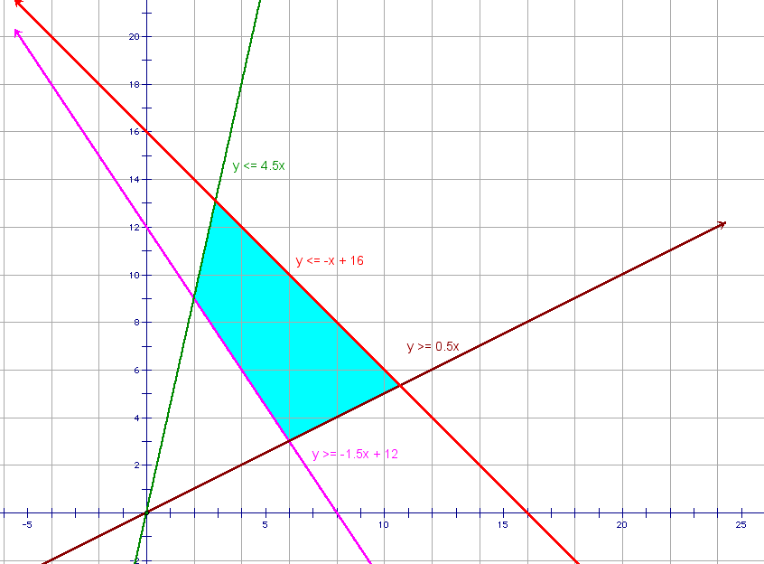
Y ≤ 4.5X
Y ≤ -X+16
Y ≥ 0.5X
Y ≥ - 0.5X+12

Slide 9
Linear Programming – A simple example
Optimal allocation of oil and gas for electricity generation
Oil & Gas for electricity generation
For a country there is a particular demand of electricity so the energy produced must be equal to the demand
Maximum oil import
Generally countries have constraint that they cant import oil too much so the have a limit to import crude.
Maximum CO2 emission
Due to environmental reason we can’t produce more than a specified amount.
Oil use for transport
For transportation purpose most of the time we rely on motor vehicles which generally use crude oil so there is minimum amount of crude oil which will be used

Slide 10


Linear Programming – A simple example
Optimal allocation of oil and gas for electricity generation
Oil & Gas for electricity generation
Oil
(x units)
Maximum oil import
Oil use for transport
Natural gas (y units)

Slide 11
THANK YOU

